Slide 1
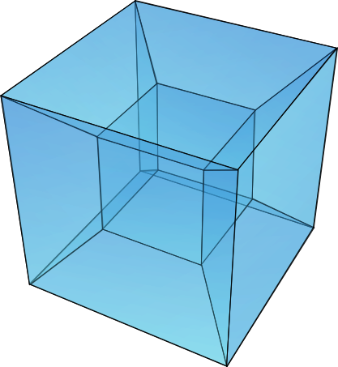
Optical Character Recognition using Tesseract in R
Donald Szlosek

Slide 2
Outline
What is Object Character Recognition (OCR)?
What is Tesseract?
How does it work?
Using Tesseract in R
Some Examples
Interactive Excersize
What is Object Character Recognition (OCR)?
What is Tesseract?
How does it work?
Using Tesseract in R
Some Examples

Slide 3
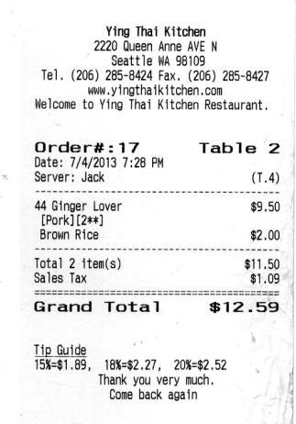
What is Optical Character Recognition
conversion of images of typed, handwritten or printed text into machine-encoded text,
Digitized Text
Receipt
Ying Thai Kitchen
2220 Queen Anne AVE N
Seattle WA 98109
Tel. (206) 285-8424 Fax. (206) 285-8427
www. yingthaikitchen.com
Welcome to Ying Thai Kitchen Restaurant,
Order#:17 Table 2
Date: 7/4/2013 7:28 PM
~ Server: Jack (T.4)
44 Ginger Lover $9.50
[Pork] [2**]
Brown Rice $2.00
Total 2 item(s) $11.50
Sales Tax $1.09
Grand Total $12.59
Tip Guide
15%=$1.89, 18%=$2.27, 20%=$2.52 ,
Thank you very much.
Come back again
OCR

Slide 4

What is Tesseract
A Brief History
OCR engine developed from 1984-1994 with HP Labs
1995 UNLV OCR Contest
2005 HP released Tesseract to the public
2006 Google sponsored it
2007+ 116 new languages added
OCR engine developed from 1984-1994 with HP Labs
1995 UNLV OCR Contest
2005 HP released Tesseract to the public
2006 Google sponsored it
2007+ 116 new languages added
Ray Smith
Sr. Staff Engineer, Google

Slide 5
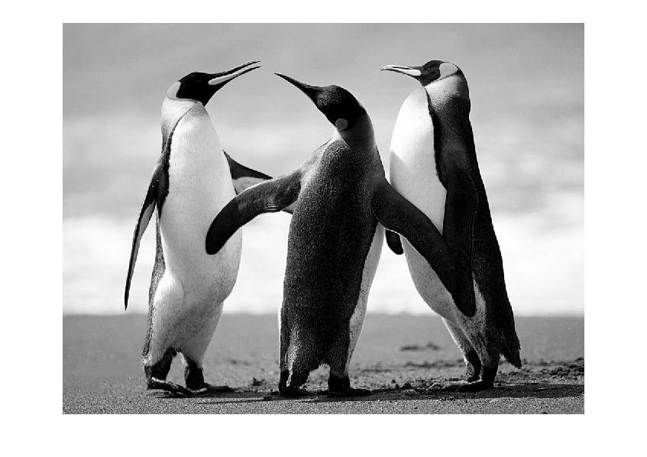
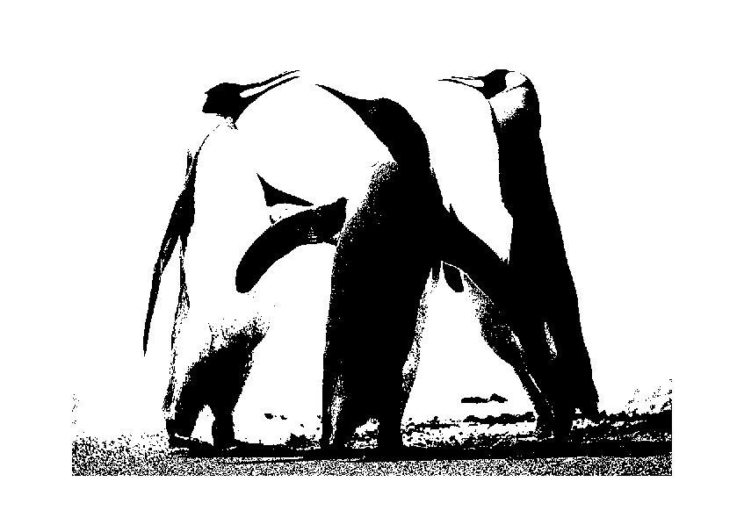
What is a Binary Image?
Some Terminology
a digital image that has only two possible values for each pixel
gray scale image
binary image

Slide 6
What is a Blob?
Some Terminology
Blob (Connected Component)
is a connected piece in a binary image
0 | 0 | 0 | 0 | 0 | 0 | 0 | 0 | 0 | 0
0 | 1 | 1 | 1 | 0 | 0 | 1 | 0 | 0 | 0
0 | 0 | 1 | 1 | 1 | 1 | 0 | 0 | 1 | 1
0 | 0 | 1 | 1 | 0 | 1 | 1 | 0 | 1 | 1
0 | 0 | 0 | 0 | 0 | 0 | 0 | 0 | 0 | 0
0 | 1 | 0 | 1 | 0 | 0 | 1 | 0 | 1 | 0
0 | 1 | 1 | 1 | 0 | 0 | 0 | 1 | 0 | 0
0 | 0 | 0 | 0 | 0 | 0 | 0 | 0 | 0 | 0

Slide 7
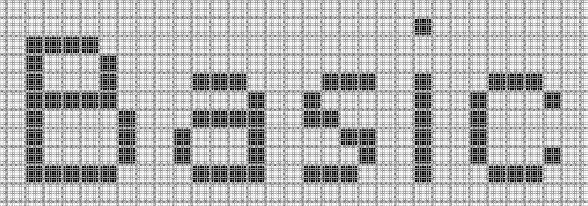
What is a Blob?
Some Terminology
Blob (Connected Component)
is a connected piece in a binary image

Slide 8
Tesseract: How does it work?
Introduction
Ensemble of multiple algorithms
9 major algorithm steps
Blob filtering and line construction are key parts of this process.
Finding the best match

Slide 9
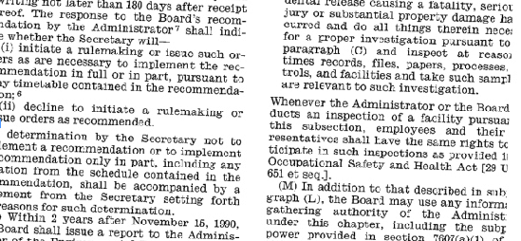
How does it work?

Slide 10
How does it work?
Blob filtering
Outlines what is a text and turns them into blobs
Smith R. “Overview of Tesseract OCR Engine.” Proc. Ninth Int. Conference on Document Analysis and Recognition (ICDAR), IEEE Computer Society (2007), pp. 629-633

Slide 11
How does it work?
Blob filtering & line construction
Outlines what is a text and turns them into blobs
Turns blobs into what it thinks are blob-lines
Smith R. “Overview of Tesseract OCR Engine.” Proc. Ninth Int. Conference on Document Analysis and Recognition (ICDAR), IEEE Computer Society (2007), pp. 629-633

Slide 12
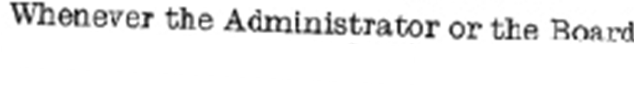
How does it work?
Blob filtering
Outlines what is a text and turns them into blobs
Turns blobs into what it thinks are blob-lines
Breaks blobs-lines into blob-words (by character spacing)
Smith R. “Overview of Tesseract OCR Engine.” Proc. Ninth Int. Conference on Document Analysis and Recognition (ICDAR), IEEE Computer Society (2007), pp. 629-633

Slide 13
How does it work?
Blob filtering
Outlines what is a text and turns them into blobs
Turns blobs into what it thinks are blob-lines
Breaks blobs-lines into blob-words (by character spacing)
Chops blob-words into blob-characters
Smith R. “Overview of Tesseract OCR Engine.” Proc. Ninth Int. Conference on Document Analysis and Recognition (ICDAR), IEEE Computer Society (2007), pp. 629-633

Slide 14
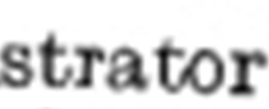
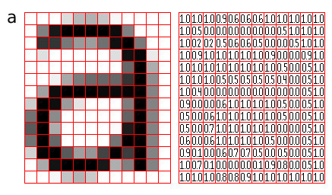
How does it work?
Text Recognition
Chops blob-words into blob-characters
Text recognition First pass (with training data)
Training Data
Smith R. “Overview of Tesseract OCR Engine.” Proc. Ninth Int. Conference on Document Analysis and Recognition (ICDAR), IEEE Computer Society (2007), pp. 629-633
Notes:
The classifier is trained on a mere 20 samples of 94 characters from 8 fonts in a single size, but with 4 attributes (normal, bold, italic, bold italic), making the total of 60160 training samples.

Slide 15
How does it work?
Text Recognition
Chops blob-words into blob-characters
Text recognition First pass (with training data)
Training Data
Recognized text
Updated
Training Data
Smith R. “Overview of Tesseract OCR Engine.” Proc. Ninth Int. Conference on Document Analysis and Recognition (ICDAR), IEEE Computer Society (2007), pp. 629-633

Slide 16
How does it work?
Text Recognition
Chops blob-words into blob-characters
Text recognition First pass (with training data)
Training Data
Recognized text
Text recognition Second pass (with updated training data)
Updated
Training Data
Smith R. “Overview of Tesseract OCR Engine.” Proc. Ninth Int. Conference on Document Analysis and Recognition (ICDAR), IEEE Computer Society (2007), pp. 629-633

Slide 17
How does it work?
Text Recognition
Chops blob-words into blob-characters
Text recognition First pass (with training data)
Training Data
Recognized text
Text recognition Second pass (with updated training data)
Updated
Training Data
a d m i n i s t r a t o r
Is this a
real word?
Linguistic Analysis
Text output
Yes
Smith R. “Overview of Tesseract OCR Engine.” Proc. Ninth Int. Conference on Document Analysis and Recognition (ICDAR), IEEE Computer Society (2007), pp. 629-633

Slide 18
Tesseract Application in R

Slide 19
Tesseract in R: Some Examples
Jeroen Ooms (US Berkeley)
maintainer
install.packages(c(“tesseract”,”magick”))

Slide 20
References
Smith R. “Overview of Tesseract OCR Engine.” Proc. Ninth Int. Conference on Document Analysis and Recognition (ICDAR), IEEE Computer Society (2007), pp. 629-633
Smith R.” The extraction and recognition of text from multimedia document images.” University of Bristol (1987). PhD thesis.
Notes:
So, Tesseract us an ensemble of 9 major steps which consists of a series of algorithms. I am not going to go into great detail but I wanted to give you all an idea of how it works.
Binary image – pixels can only be two possible values (usually black/white).

Slide 22
Algorithm in Detail

Slide 23
Tesseract: How does it work?
Introduction
Ensemble of multiple algorithms
9 major algorithm steps
Blob filtering and line construction are key parts of this process.

Slide 24
Tesseract: How does it work?
Introduction
Component Outlines In Text Regions
Character Outlines Organized Into Words
Character Outlines In Text Regions
Input: Binary Image
Page Layout Analysis
Blob Finding
Find Text Lines and Words
Recognize Word Pass 1
Character Associater
Character Chopper
Fuzzy Space & x-height Fix-up
Recognize Word Pass 2
Output: Text
Done?
Yes
Static
Character
Classifier
Dictionary
Adaptive
Character
Classifier
Number
Parser
Adapt to
Word

Slide 25
Line and Word Finding
Y
“
ou don't have to see the whole staircase. Just take the first step.” Martin Luther King
Notes:
1. Line Finding
Algorithm is designed so that skewed page can be recognized without having to deskew, thus preventing any loss of image quality.
Blob filtering and line construction are key parts of this process.
Under the assumption that most blobs have uniform text size, a simple percentile height filter removes drop-caps and vertically touching characters and median height approximates the text size in the region.
Blobs smaller than a certain fraction of the median height are filtered out, being most likely punctuation, diacritical marks and noise.
The filtered blobs are more likely to fit a model of non-overlapping, parallel, but sloping lines. Sorting and processing the blobs by x-coordinates makes it possible to assign blobs to a unique text line, while tracking the slope across the page.
Once the lines are assigned, a least median of squares fit is used to estimate the baselines, and filtered-out blobs are fitted back into appropriate lines.
Final step merges blobs that overlap by at least half horizontally, putting diacritical marks together with the correct base and correctly associating parts of some broken characters.

Slide 26
Line and Word Finding
Y
“
ou don't have to see the whole staircase. Just take the first step.” Martin Luther King
percentile height filter removes drop-caps and vertically touching characters
Median height of text calculated
Notes:
percentile height filter removes drop-caps and vertically touching characters

Slide 27
Line and Word Finding
Y
“
ou don't have to see the whole staircase. Just take the first step.” Martin Luther King
Blobs smaller than a certain fraction of the median height are filtered out (punctuation)
Notes:
Blobs smaller than a certain fraction of the median height are filtered out, being most likely punctuation, diacritical marks and noise.

Slide 28
Line and Word Finding
Y
“
ou don't have to see the whole staircase. Just take the first step.” Martin Luther King
track the blobs across the x-axis and look at the slope of each blob to detect what line they might be on
Notes:
Next they track the blobs across the x-axis and look at the slope of each blob to detect what line they might be on
There are some additional steps here, like using a median regression to try and estimate the baseline and add back in filtered out blobs

Slide 29
Estimating Blob Lines
Y
“
ou don't have to see the whole staircase. Just take the first step.” Martin Luther King
track the blobs across the x-axis and look at the slope of each blob to detect what line they might be on
Notes:
Next they track the blobs across the x-axis and look at the slope of each blob to detect what line they might be on
There are some additional steps here, like using a median regression to try and estimate the baseline and add back in filtered out blobs
Baseline fitting is done by partitioning the blobs into groups of reasonable continuous displacement for the original straight baseline

Slide 30
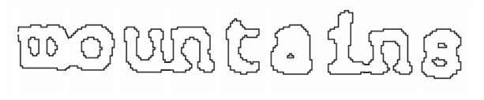
Fixed Pitch Detection and Chopping
Notes:
After all that, you have something that looks like this
A series of blobs that are possibly connected to one another and whether they are fixed pitch text (same width)
Looks at blobs and tried to estimate the width of the words and then chops it

Slide 31
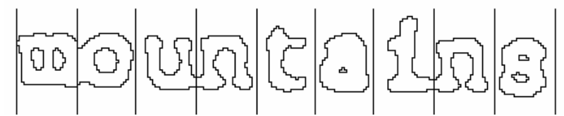
Fixed Pitch Detection and Chopping
Chopping words by estimated monotonic text width
Notes:
After all that, you have something that looks like this
A series of blobs that are possibly connected to one another and whether they are fixed pitch text (same width)
Looks at blobs and tried to estimate the width of the words and then chops it

Slide 32
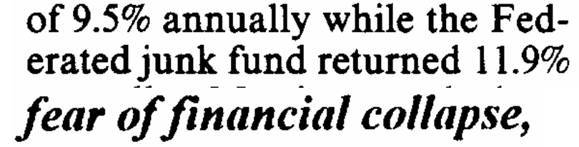
When Estimated Text Width Doesn’t work: Proportional Word finding
measuring gaps in a limited vertical range between baseline and mean line. Spaces close to a threshold are made fuzzy, where the decisions are made after word recognition.
Notes:
After all that, you have something that looks like this
A series of blobs that are possibly connected to one another and whether they are fixed pitch text (same width)
Looks at blobs and tried to estimate the width of the words and then chops it

Slide 33
When Estimated Text Width Doesn’t work: Proportional Word finding
No gap
measuring gaps in a limited vertical range between baseline and mean line. Spaces close to a threshold are made fuzzy, where the decisions are made after word recognition.
Notes:
You can see it is not easy to calculate due to the lack of gap for between of and financial

Slide 34
When Estimated Text Width Doesn’t work: Proportional Word finding
No gap
measuring gaps in a limited vertical range between baseline and mean line. Spaces close to a threshold are made fuzzy, where the decisions are made after word recognition.
Notes:
You can see it is not easy to calculate due to the lack of gap for between of and financial
The gap in between the 1 and the nine in 1.9% is much larger than in any of the works in “erated”
Just another reason to attempt word recognition PRIOR to

Slide 35
Word Recognition

Slide 36
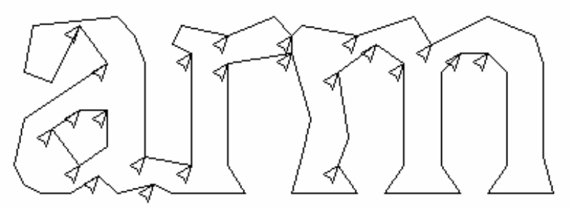
Chopping Joined Characters
Notes:
Tesseract attempts to improve the result by chopping the blob with worst confidence from the character classifier.
Chop points are found from concave vertices of a poligonal approximation of the outline.
It may take upto 3 pairs of chop points to successfully separate joined characters from ASCII set.
Any chop that fails to improve the confidence of the result is undone (but not discarded bc it could be re0used as an associator

Slide 37
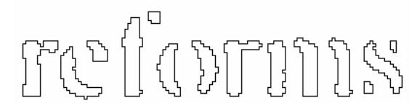
Associating Broken Characters
Notes:
After the potential chops have been exhausted, if the word is still not good enough, it is given to the associator, which makes a best first search of the segmentation graph of the possible combinations of the maximally chopped blobs into candidate characters.

Slide 38
Static Character Classifier

Slide 39
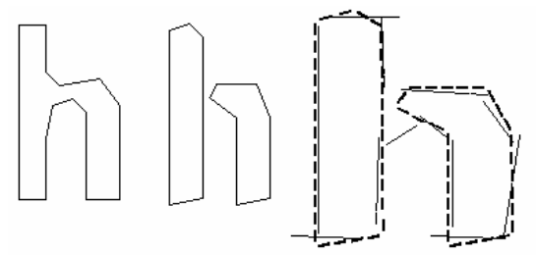
Features
Notes:
Another idea for classification involved use of segments of the polygonal approximation as features, but this method is also not robust to damaged characters.
During training, segments of a polygonal approximation are used for features, but during recognition, features of a small, fixed length are extracted from the outline and matched many-to-one against the clustered prototype features of the training data.
The process of small features matching large prototypes is easily able to cope with recognition of damaged words.

Slide 40
Classification
This stage proceeds as a two-step process. First step involves a class prunerthat creates a shortlist of character classes that the unknown might match.
The classes shortlisted in step one are taken further to the next step, where the actual similarity is calculated from the feature bit vectors. Each prototype character class is represented by a logical sum-of-product expression with each term called a configuration.

Slide 41
3. Training Data
The classifier is trained on a mere 20 samples of 94 characters from 8 fonts in a single size, but with 4 attributes (normal, bold, italic, bold italic), making the total of 60160 training samples.

